Slide 1

“History and Overview of the HCV Elimination Program”
Minister Of Labour Health and Social Affairs of Georgia
Dr. David Sergeenko

Slide 2

Hepatitis C under the Global Fund project free of Charge Hepatitis C treatment with Peg/Riba regimens for HIV/HCV co-infected patients with Peg/Riba
Free of Charge Hepatitis C treatment with Peg/Riba regimens for prisoners.
10 000 Patients from civil sector were offered a 60% discount for medicines (Peg/Riba)
We began negotiations with US CDC, Gilead and other US partners
1st National Workshop on Hepatitis C, March 12-14, 2014
National Committee for HCV elimination program was established

Slide 3

Activities in Preparation of Launch of HCV Elimination Program
Infection control and prevention policy documents and guidelines were updated
Development of HCV treatment database “Stop C” (adapted from existing)
Physician trainings were conducted on updated protocols and guidelines
National workshop on Short /urgent measures of Hepatitis C elimination action plan
HCV elimination action plan was approved and state program launched; necessary to obtain government funding for the program

Slide 4

APRIL 21th
Memorandum of Understanding between Georgian Government and Gilead was signed

Slide 5

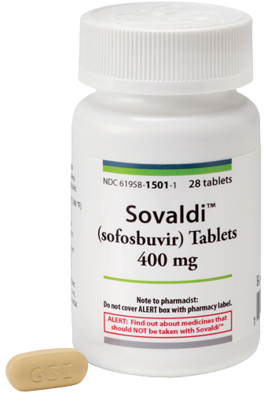
Large-scale PR campaigns launched with multi-sectorial approach and awareness raising
Initially 4 provider clinics were selected to provide treatment; a multi-sector committee reviewed records for eligibility for treatment (initially limited to patients with severe liver disease)
On May 1 Georgia received initial stock of “Sovaldi”

Slide 6
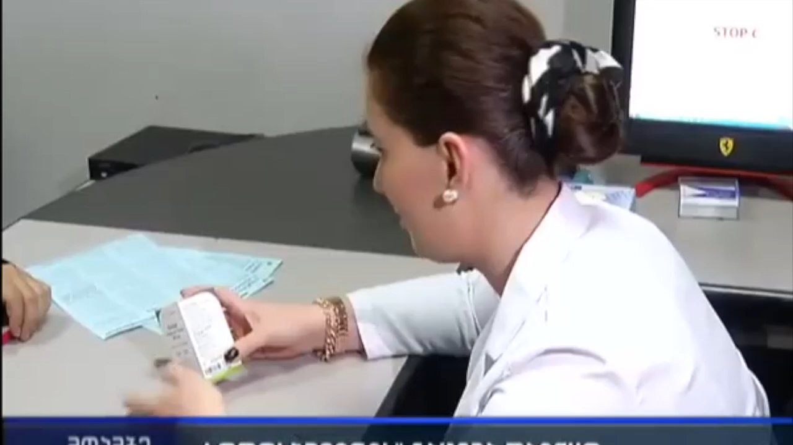
On May 15th the first patient received treatment “Sovaldi”
The initial phase included prioritizing patients with severe liver disease.
Free screening
US CDC published an article in the MMWR on World Hepatitis Day: “The Launch of a Hepatitis C Elimination Program in the Country of Georgia”

Slide 7



Project „ECHO” (Extension for Community Healthcare Outcomes) in the framework of L.I.F.E.R. (Liver Institute and foundation for education and research) was implemented
External Hepatitis Technical Advisory Group (TAG) formed, first meeting in Tbilisi, Georgia, 3-4 November
AASLD 2015 WHO symposium Georgia had presentation about hepatitis C elimination Program

Slide 8
Regulations oblige all inpatient institution to screen all hospitalized patients
Screening guidelines have been developed
Within updating new guidelines and considering new regimens committee members were trained by Gilead
Assessment of “Stop C” was performed

Slide 9

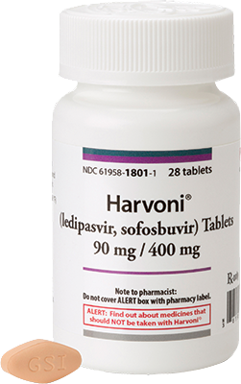
Work began for development of new database “Elimination C“ to replace “STOP-C” with support of partners
Treatment Guidelines updated
First stock of “Harvoni” received
Evaluation of HCV core antigen (Abbott) was conducted

Slide 10
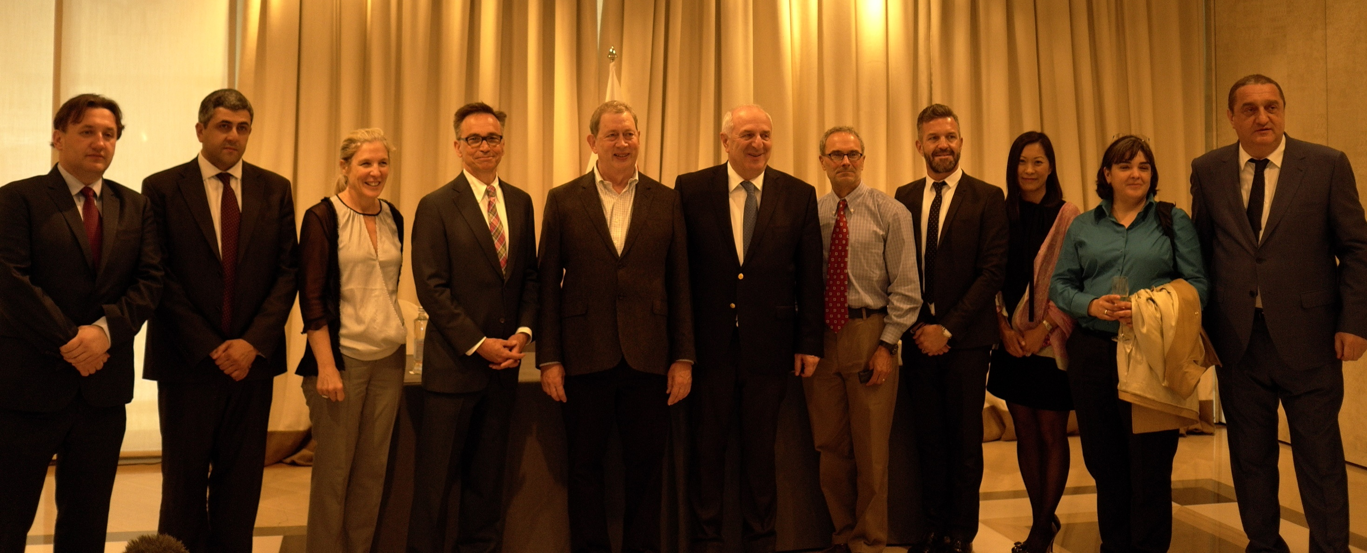
Clinical group was established
3rd National Workshop on HCV was held main objective was the summarizing of long-term elimination plan
April EASL conference and a side session for Georgia
Long term agreement between Gilead Sciences and Georgia Government was signed at EASL

Slide 11
June 10TH 2016
New HCV Center opened in Tbilisi
New “Elimination С” program launched
Eligibility criteria were relaxed allowing all patients regardless of severity of liver disease

Slide 12
„ECHO” was expanded with Georgian Centers serving as “Hubs” supporting local facilities
Symposium for National Guidance and Education By Lifer and Project “ECHO”
On 18 August long term action plan strategy was approved by government of Georgia
Second TAG meeting was held on October 24-25
Georgia HCV Elimination Scientific Committee was established.

Slide 13

MMWR National Progress toward Hepatitis C Elimination — Georgia, 2015–2016
Gilead movie
4th National Hepatitis C Elimination Workshop
Opening of Zugdidi screening and management Center
Drug Distribution
Live Committee

Slide 14
Georgia’s HCV Elimination Program Treatment Database
(Apr 28, 2015 – Dec 31, 2016)
Screened | 470 000
HCV RNA + | 36 322
Started treatment | 27 595
Completed treatment | 19 778
Ongoing treatment | 7280
Not completed treatment | 537
Treatment outcomes - Sofosbuvir | 80 %
Treatment outcomes - Sofosbuvir/Ledipasvir | 98.2 %

Slide 15

Future Goals
Negotiations are ongoing to attract partners in order to increase access to screening
Unified Screening database is under development and should be introduced shortly
Georgia HCV elimination website is under development
Strategy for inclusion of target Groups as PWID
Annual report is under development

Slide 16
Acknowledgements
Ministry of Labour, Health and Social Affairs
Gilead Sciences, Inc
US Centers for Disease Control and Prevention (CDC)
TAG Members
State, Clinical and scientific committee of Hepatitis C Elimination Program
Clinics

